Slide 1
Slug Testing
CNYAPG Geology Field Days
April 26, 2024
Presented by:
Yuri Veliz
Gerry Gould

Slide 2
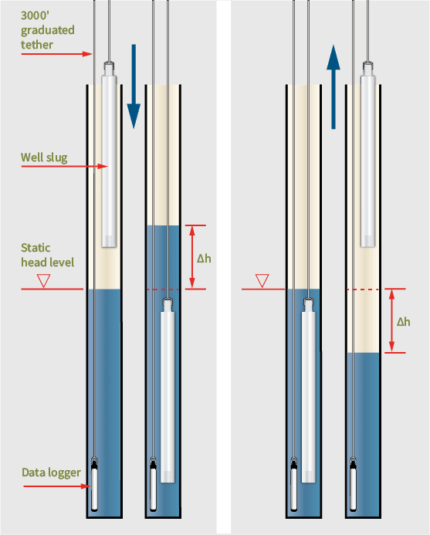
Rising Head
Falling Head

Slide 3
Slug Test Procedure – Falling Head
Open well
Measure depth to water
Measure depth to bottom
Record well specifications on Slug test data sheet
Install pressure transducer sufficiently below top of water column to avoid interference with slug
Connect to PC and allow water to equilibrate
Program measurement frequency using software
logarithmic scale – frequent measurements at start
Fewer measurements as time passes
Lower slug to just above water surface (raise slug for rising head test)
Start recording measurements on software – record a few readings before submerging the slug
Submerge the slug and tie off so it won’t drop any deeper
Continue recording data until water level has returned to pre-slug depth – watch the real-time display
Record water level with water level indicator to confirm that the transducer hasn’t accidentally moved
Hand record a few data point on the data sheet
Stop computer data recording. Save data file
Re-set measurement frequency and repeat

Slide 4
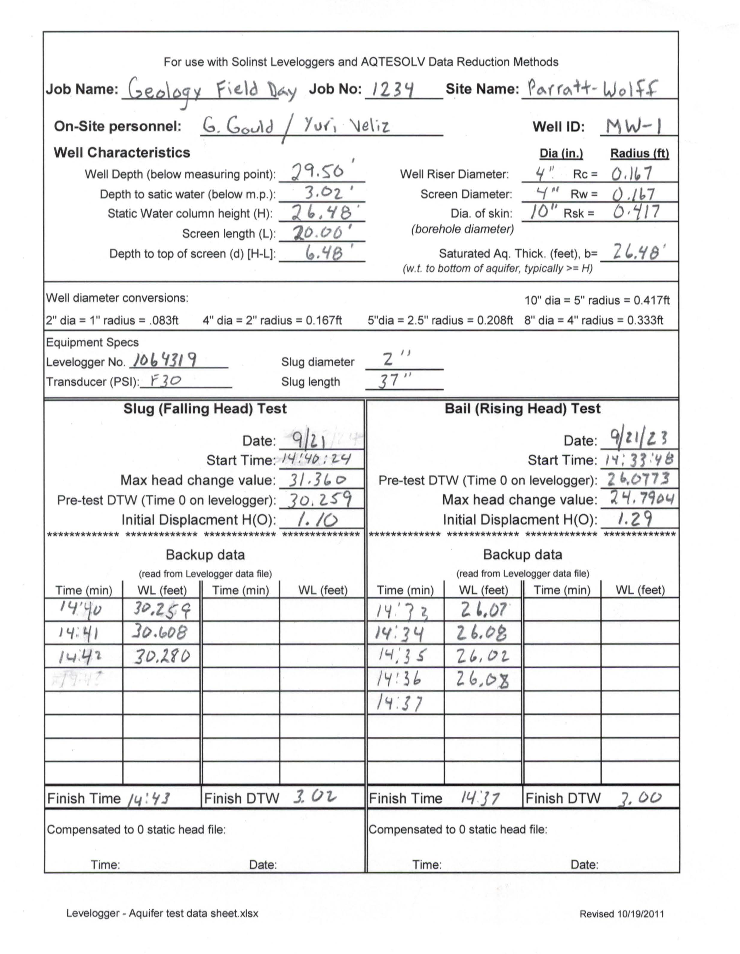
Slug test field data sheet

Slide 5
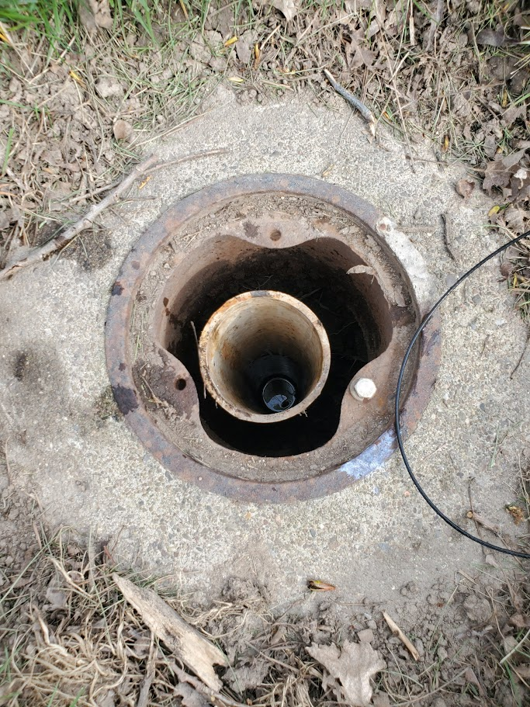
4” diameter PVC monitoring well
Water surface is visible inside well

Slide 6
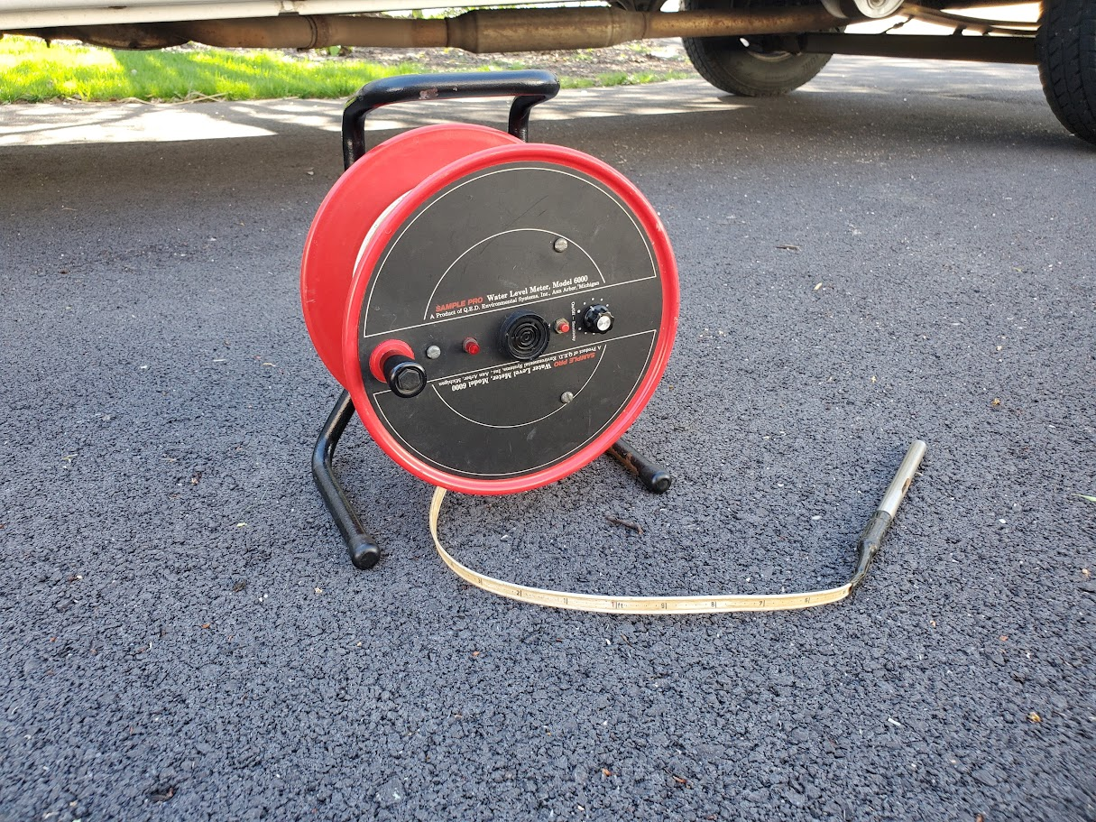
Water level indicator used to determine depth to groundwater

Slide 7
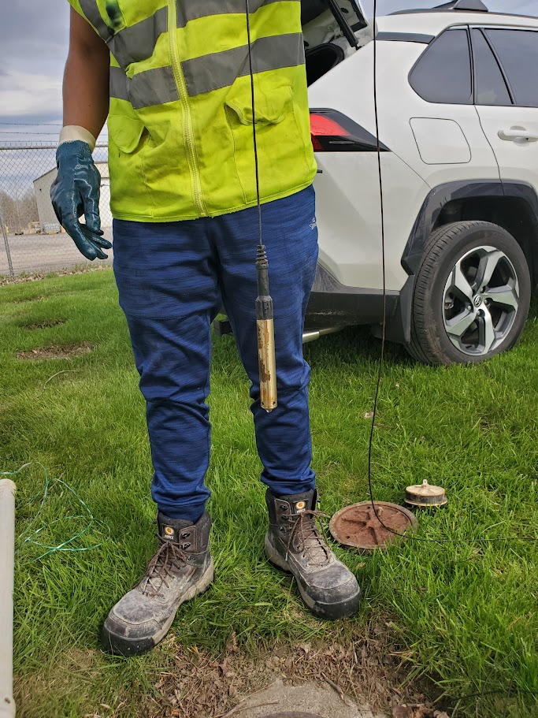
Pressure Transducer

Slide 8
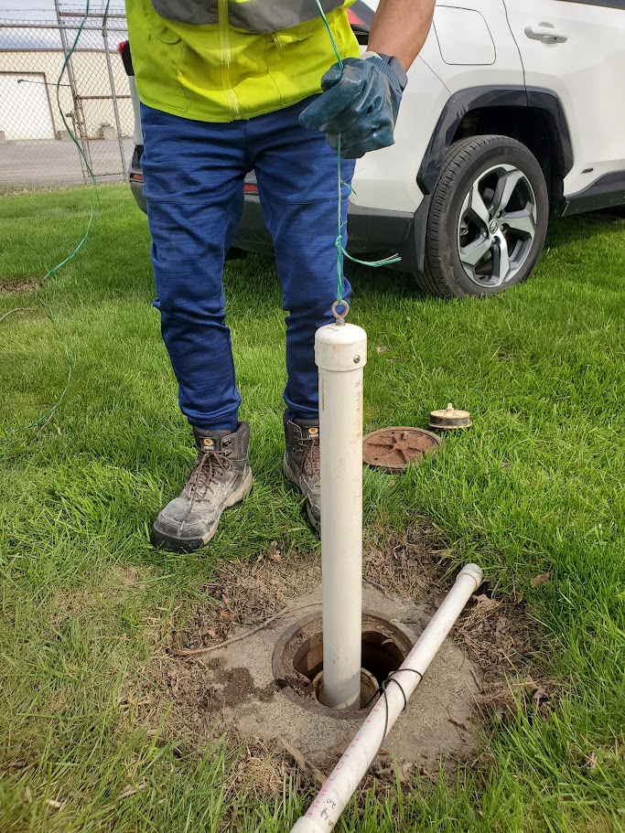
Slug being lowered to just above water surface to minimize splashing

Slide 9
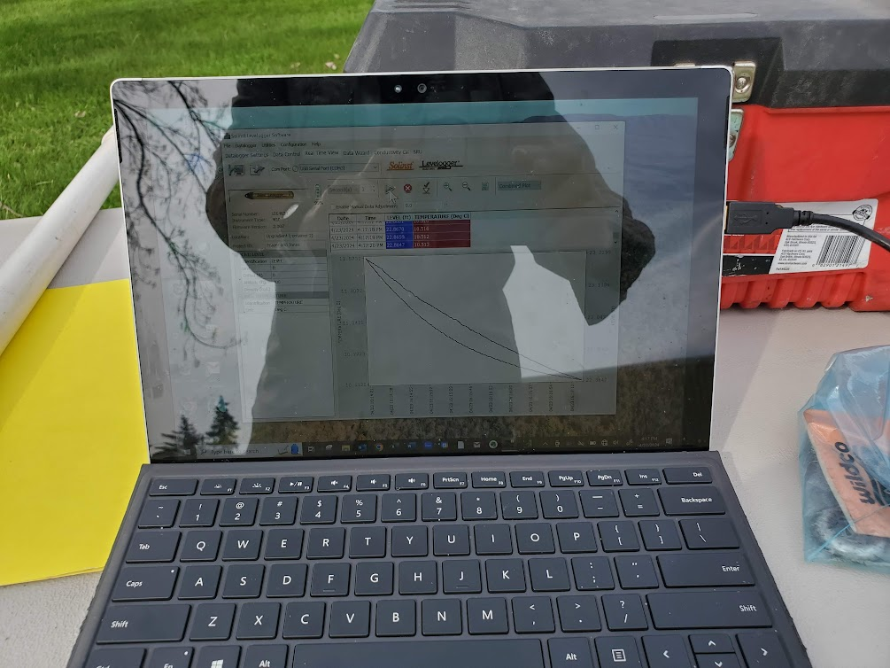
Laptop PC running data logging software - showing real time measurements

Slide 10
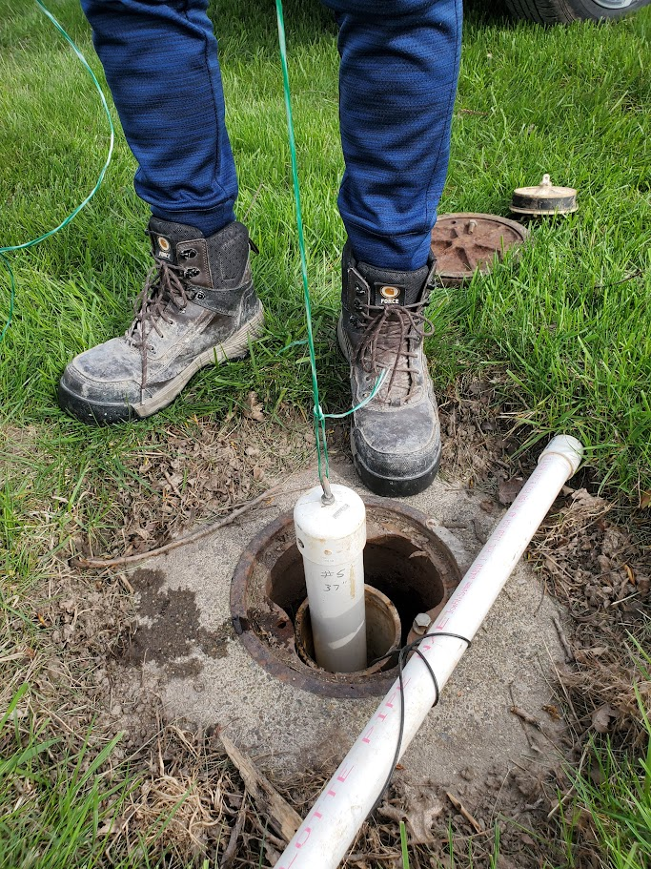
Slug ready to be lowered into water for falling head test

Slide 11
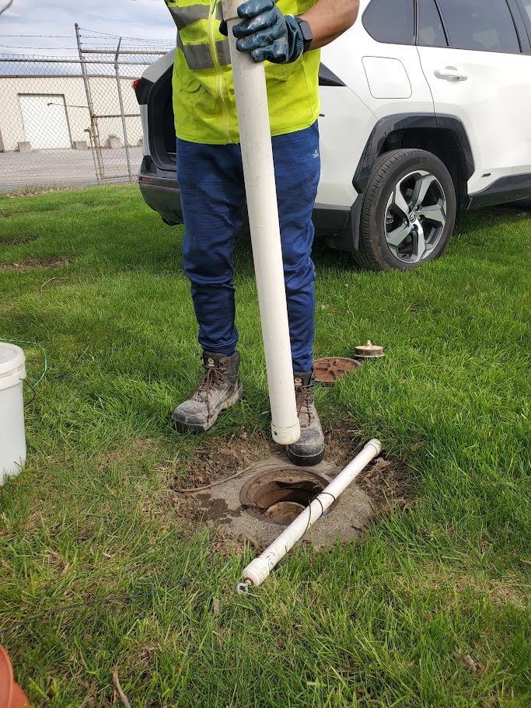
Slug removed for rising head test

Slide 12
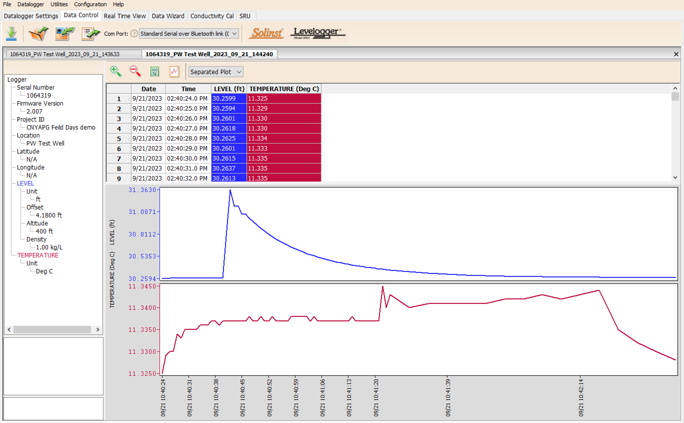
Falling Head
Temperature

Slide 13
Rising Head

Slide 14
End

